Slide 1

Sales Distribution Dashboard.
Using excel

Slide 2
PROJECT OVERVIEW:
To build a dynamic sales distribution dashboard that tracks sales performance across different regions, products, and time periods.
Excel worksheet includes:
This includes the data of the year 2021 Sales distribution of different products all over the world.
Input Data.
Target Data.
Customer Data.
Analysis.
Final Dashboard.
Data Modelling:
Input data is cleaned and modified using VLOOKUP(mainly) and other excel formulas, from target and customer data.
Depending on the modified input data a analysis sheet is created using pivot table for data visualization process.
Different charts are created and other data visualization for better understanding using the pivot tables from analysis sheet.
Slicers are used to see the changes for the each month and every region all over the world in the dashboard.

Slide 3
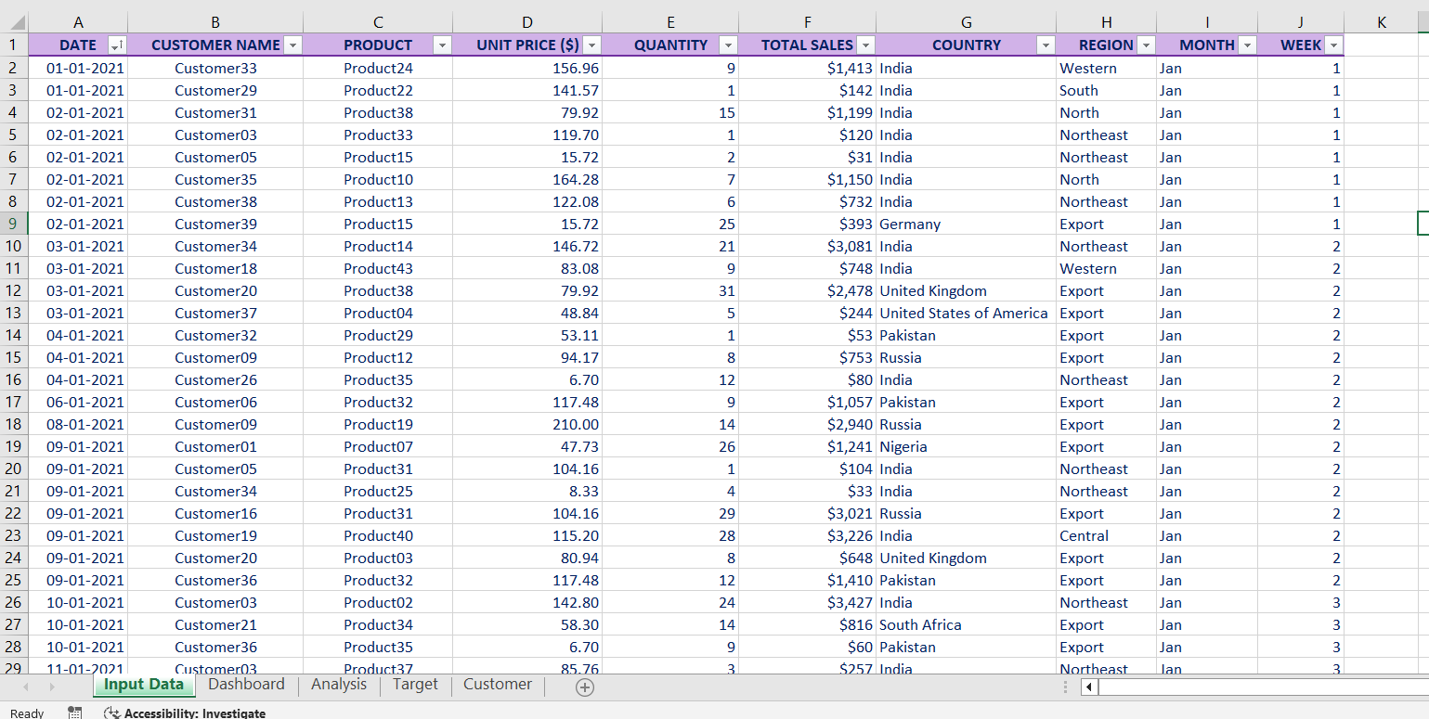
INPUT DATASET:

Slide 4
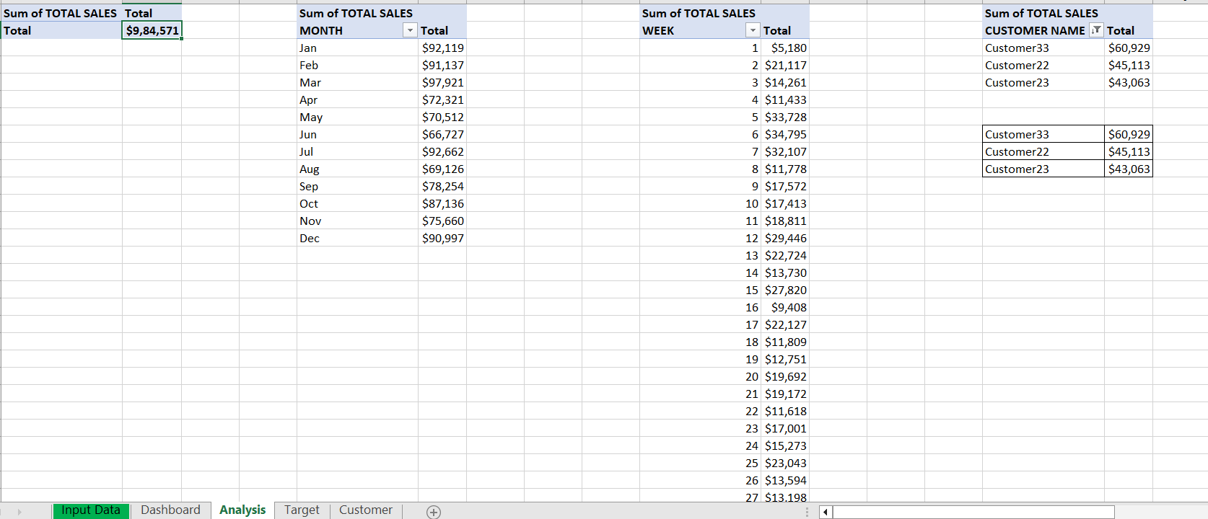
ANALYSIS SHEET:

Slide 5
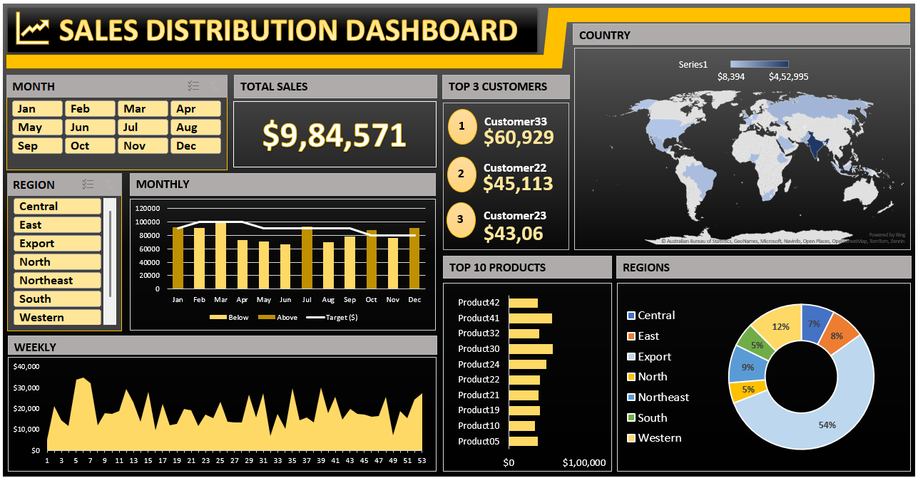
SALES DASHBOARD:

Slide 6
CONCLUSION:
This dashboard offers a comprehensive view of the company’s sales performance across multiple dimensions:
Total Sales: Displays cumulative revenue of $9,84,571 for the selected time period.
Regions: Sales performance by region, with Export dominating at 54%.
Top Customers: Lists the top 3 contributing customers, with Customer33 leading.
Top Products: Identifies the top-selling products, with Product30 generating the highest revenue.
Monthly/Weekly Trends: Shows fluctuations in sales over time, highlighting periods of peak and below-target sales.
Geographic Distribution: Visualizes country-level sales data globally.
Slicers are used for Months and Regions to provide interactivity, allowing targeted analysis.
In summary, the sales data for 2021 underscores both significant achievements and areas for improvement. The year demonstrated robust performance in export region, showcasing strengths and market potential. By building on the successes and addressing the challenges identified, it can position itself for even greater success in the upcoming year. The insights from this year’s data provide a solid foundation for refining our approach and achieving our sales goals with renewed focus and strategy.

